Slide 1
Web Development
BSc Applied Computing / Forensics / Entertainment Systems/ IOT
Eamonn de Leastar (edeleastar@wit.ie)
Dr. Brenda Mullally (bmullally@wit.ie)

Slide 2
Agenda
The Web Development Module
The Internet
The Web
The Labs

Slide 3
Web Development
Tuition Team:
Eamonn de Leastar (edeleastar@tssg.org)
Dr. Brenda Mullally (bmullally@wit.ie)
12 Week Module
2 Lecture
+1 x 2 hour supervised lab
100% Continuous assessment
2 Assignments during term.

Slide 4

Recommended Text
Head First HTML and CSS, 2nd Edition. By Freeman, Elisabeth and Eric Freeman. 2012. Head First HTML with CSS & XHTML . O'Reilly & Associates. 658 p. ISBN 978-0-596-15990-0
£17 on amazon (new)

Slide 5
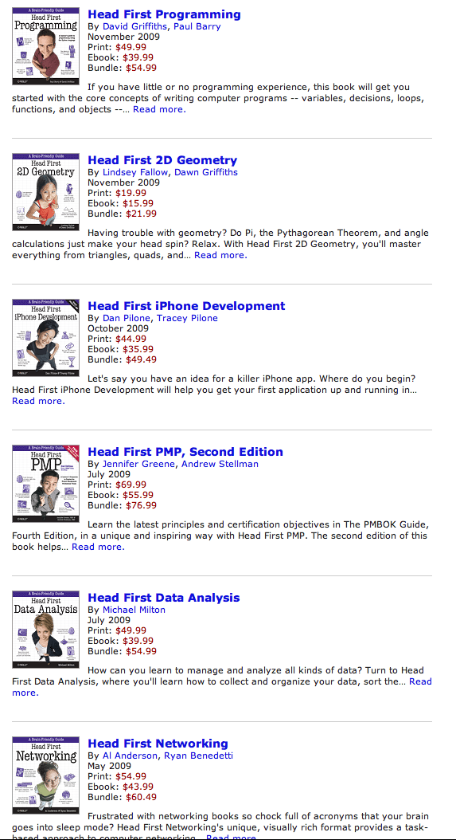
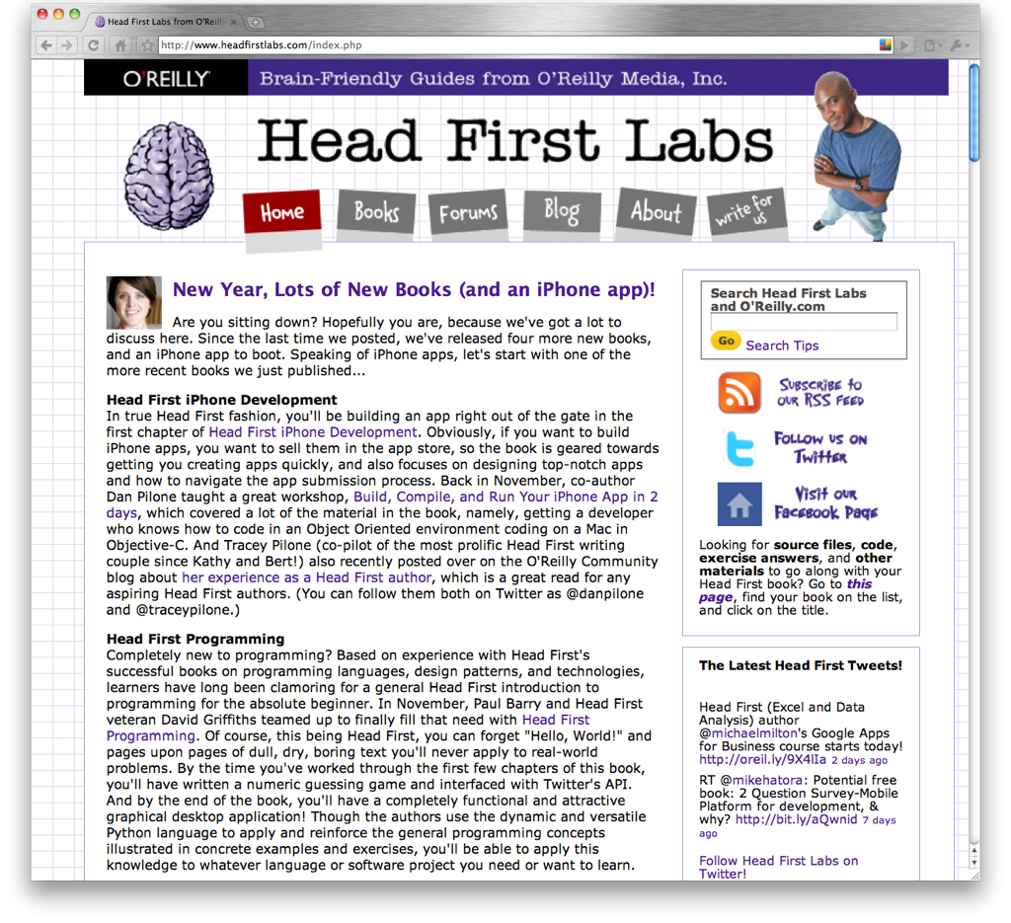

Slide 6
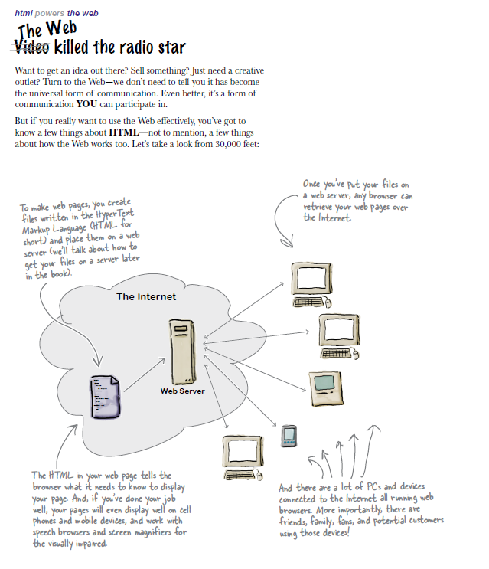
A flavour of the book…

Slide 7
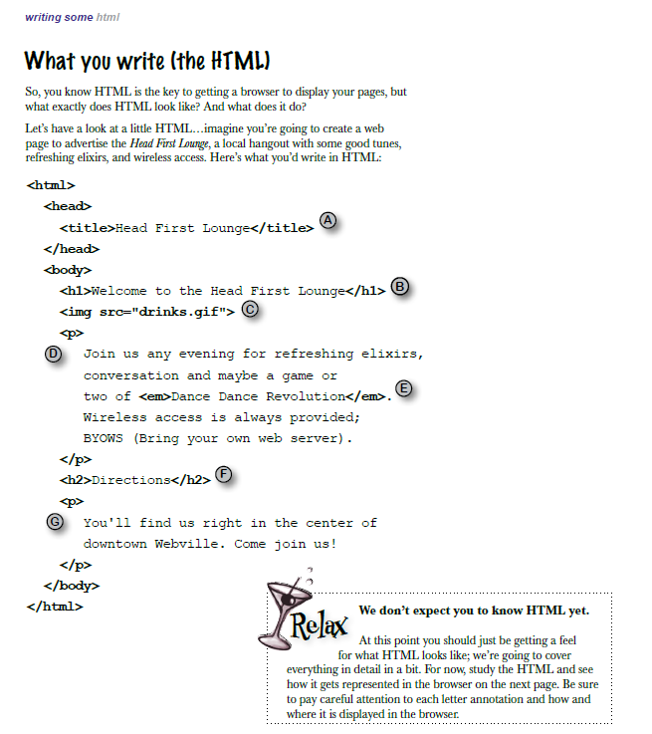
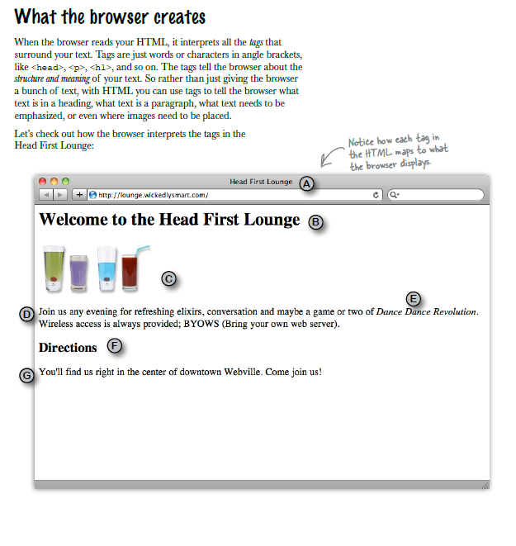
A flavour of the book…

Slide 8
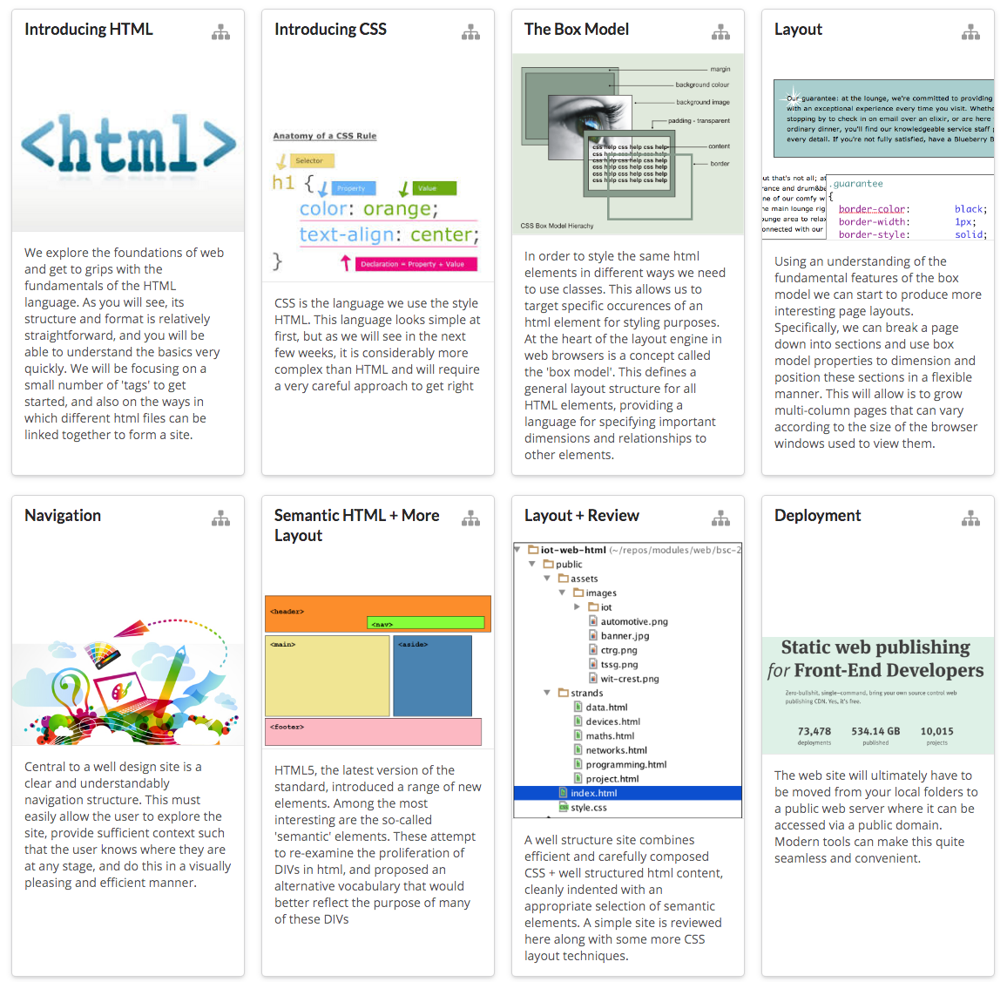
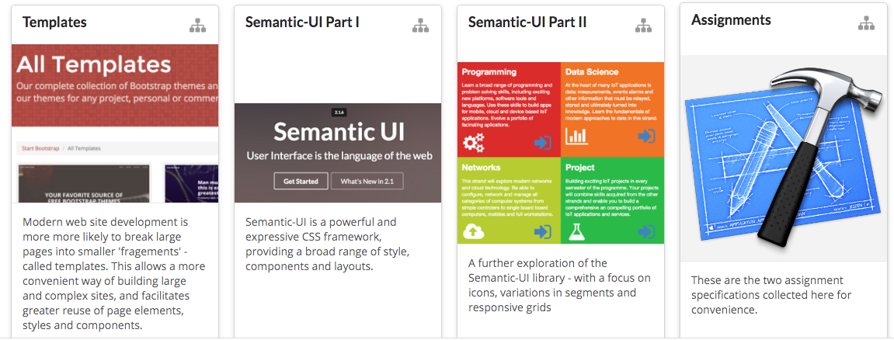
Web Development: House of Cards
12 Topics in Web Development – one topic per week
Each Topic builds on concepts, tools and techniques from previous weeks.

Slide 9
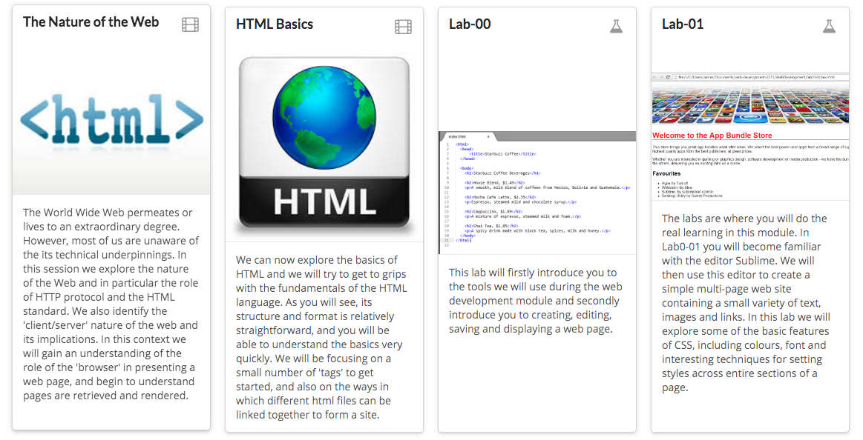
Week 1 – Introducing HTML
Slides for next lecture
These slides
Labs for this week

Slide 10
CODE is King (or Queen)
The language of the Web:
Hypertext Markup Language - HTML
Cascading Style Sheets - CSS
Build over successive labs a simple web sites from scratch.
Focus on the structure and meaning of:
CODE - html, css

Slide 11
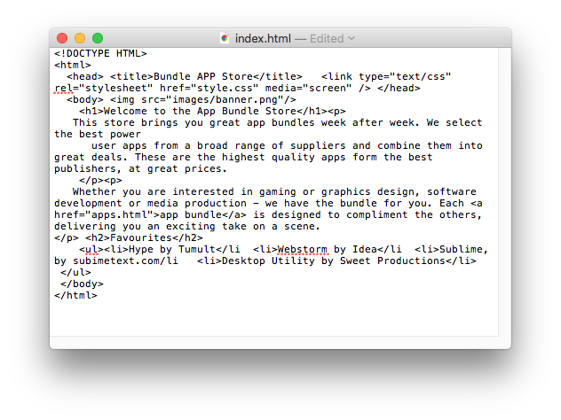
The Code in a Conventional Editor
The actual document text - but poorly structured (indented)

Slide 12
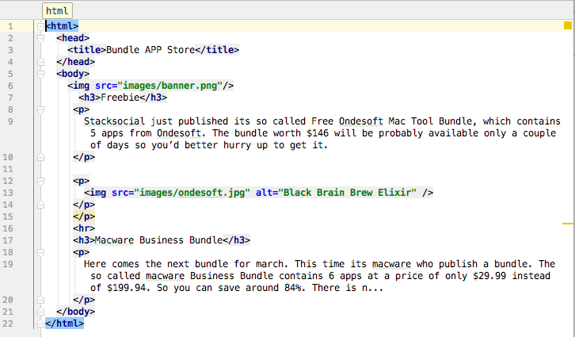
The Code in a Programmers Editor
Same document - pleasingly indented and syntax highlighted
12

Slide 13
Agenda
The Module
The Internet
The Web
The Labs

Slide 14
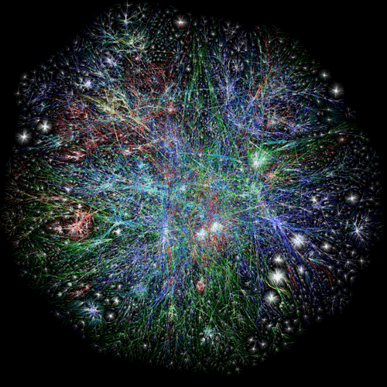
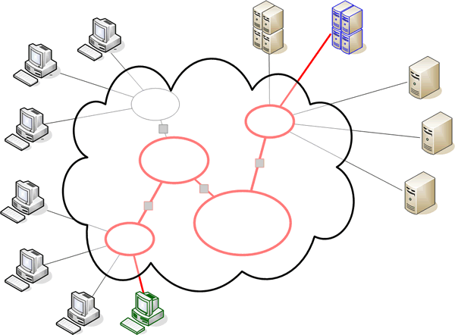
The Internet

Slide 15
The Internet
Global network infrastructure connecting millions of computers.
More than 190 countries linked
3,137,102,200 Internet users (04/06/2015 www.internetlivestats.com)
952,105,920 websites.

Slide 16
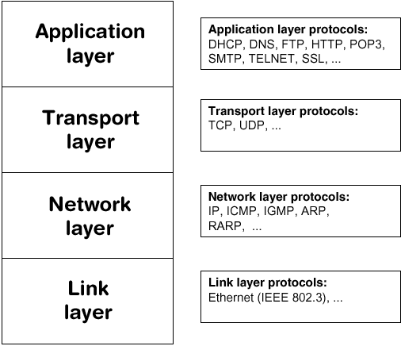
Underlying nature of the Internet - Protocols & Standards
You are here!
HTTP
“The irony is that in all its various guises -- commerce, research, and surfing -- the Web is already so much a part of our lives that familiarity has clouded our perception of the Web itself.”
Tim Berners-Lee in Weaving the Web
Internet Technologies

Slide 17
Agenda
The Module
The Internet
The Web
The Labs

Slide 18

World Wide Web
The world wide web is a huge globally distributed collection of information and data that can be accessed via the internet with the help of of http: Hypertext Transfer Protocol
WWW has made the Internet the most important communication medium of our days.
Thanks to the simple to use graphical interface – The Web Browser – the WWW provides everyone with simple access to information

Slide 19
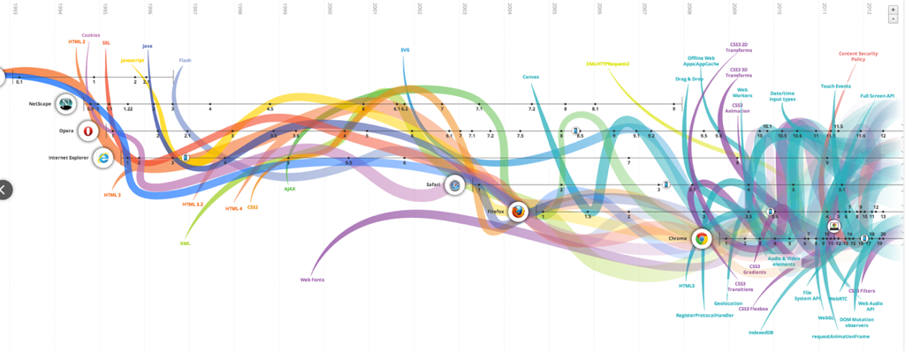
Evolution of the Web - 1990-2012

Slide 20
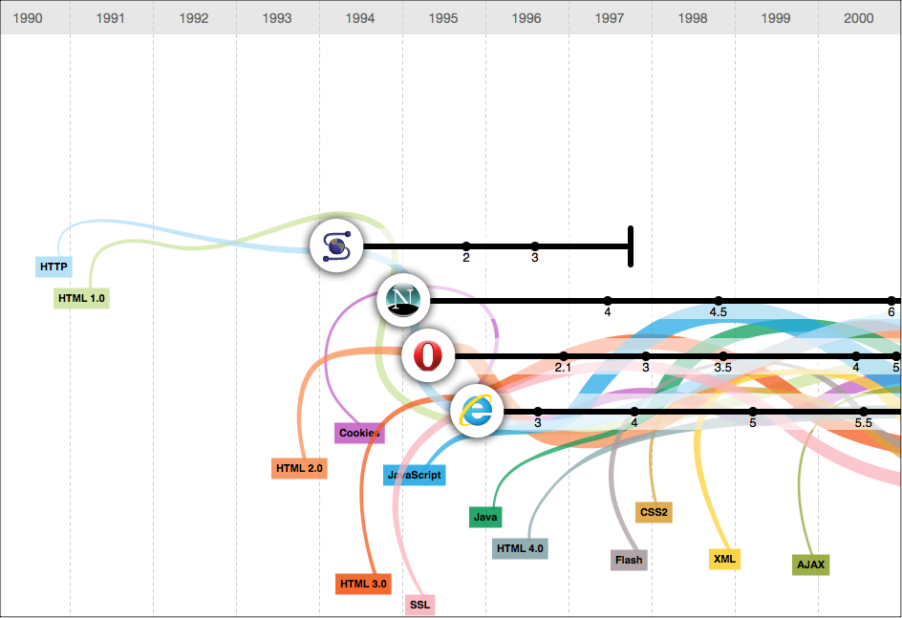
Evolution of the Web - 1990-2000

Slide 21
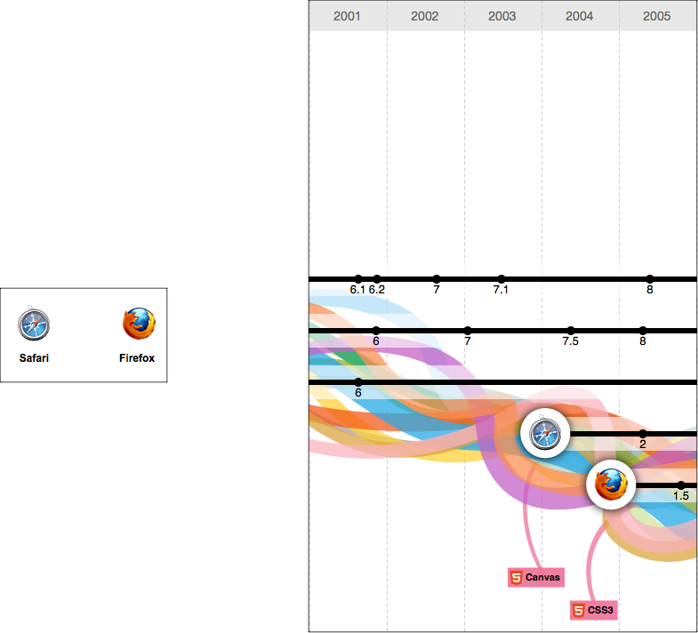
2001-2005

Slide 22
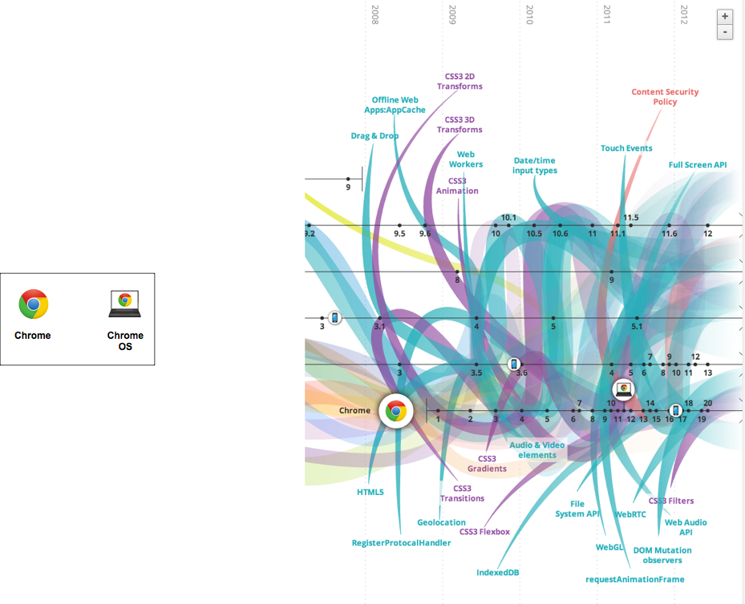
2006-2012

Slide 23
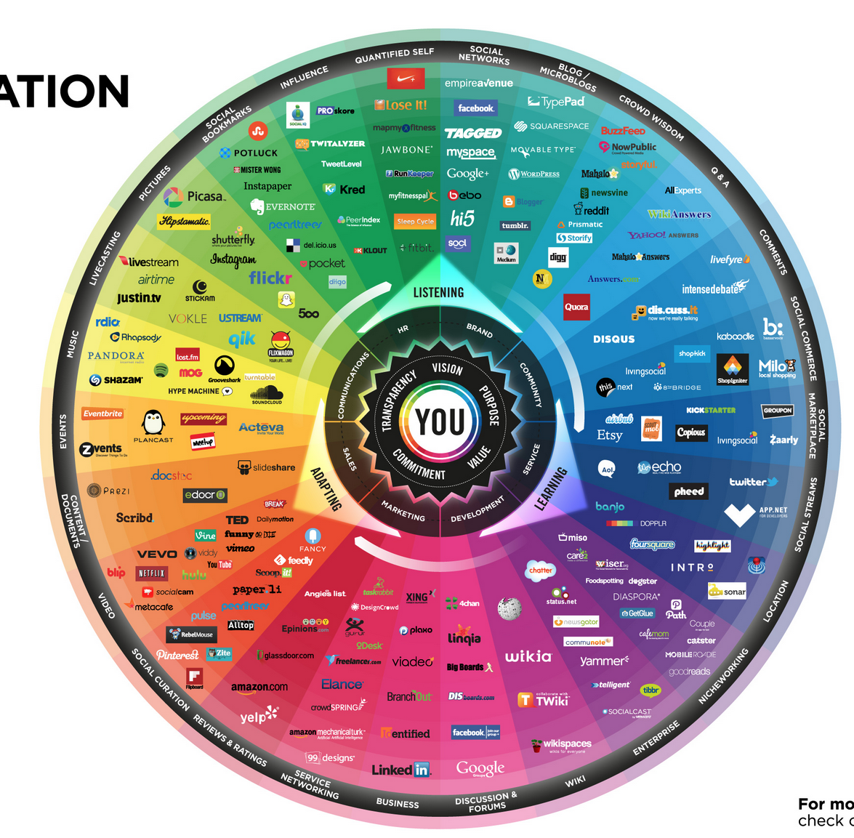
conversationprism.com

Slide 24

Devices: Conventional

Slide 25
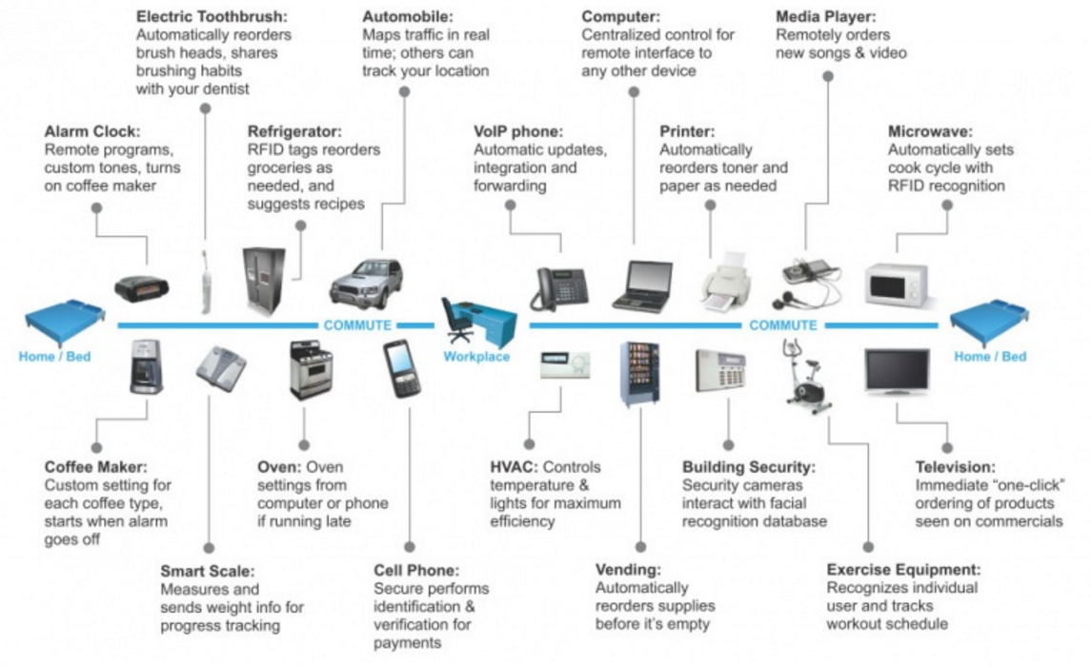
Devices: Things!

Slide 26
The Web
Protocols & Standards
Protocol : agreed vocabulary to enable two programs to communicate
Standard: an agreed definition of the structure and meaning of a document
Web Protocol
Hyper Text Transfer Protocol - HTTP
Web Standard
Hyper Text Markup Language – HTML
Cascading Style Sheets - CSS
Web Servers and Web Browsers use HTTP to exchange HTML documents

Slide 27

Clients and Servers
Client/Server Computing:
The interaction between two programs when they communicate across a network.
A program at one site sends a request to a program at another site and awaits a response.
The requesting program is called a client; the program satisfying the request is called the server.

Slide 28
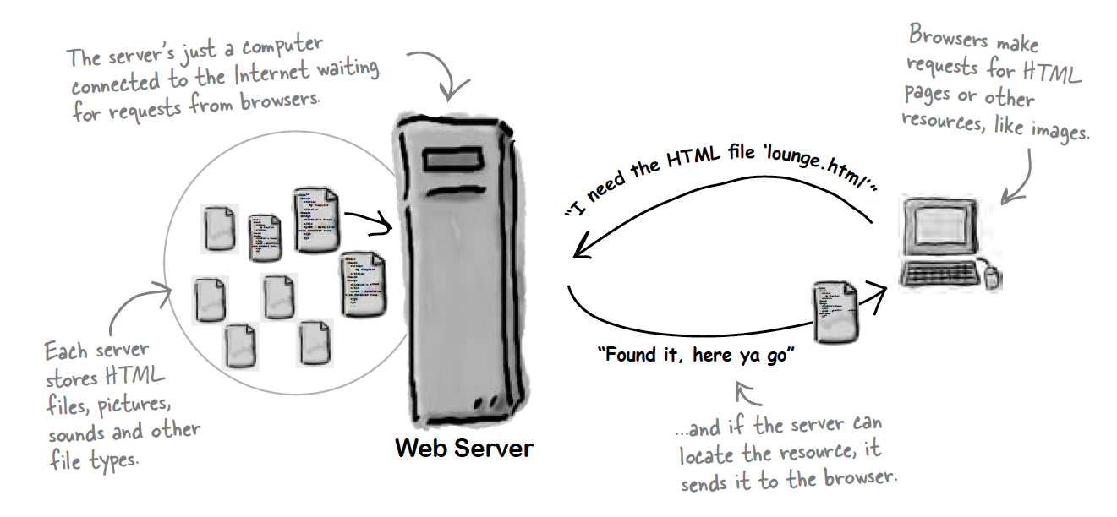
Role of Server

Slide 29
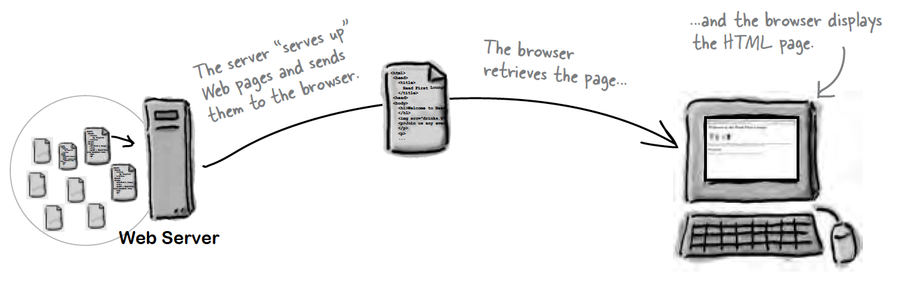
Role of Client

Slide 30
Hyper Text Markup Language
HTML tells your browser about the structure of your document:
where the headings are,
where the paragraphs are,
what text needs emphasis, etc
what text needs to linked
what images to be displayed
Given this information, browsers have built-in default rules for how to display each of these elements.
This information is conveyed using “Tags”, this denote the intention of the author regarding the structure and display of the document.

Slide 31
HTML
An HTML document is called a ‘page’
The starting page of a site is called the ‘homepage’
Markup language should only be used for the description of the document structure and not to describe the document presentation
Every HTML document consists of two parts:
Document ‘header’: contains information about the document.
Document ‘body’: contains the content of the document.

Slide 32
HTML Tags (more correctly called Elements)
Tags for this week
Grouped by purpose:
Structural
<html>, <head>, <title>, <body>
Text
Heading
<h1>, <h2>
Text
<p>, <em>
Hypertext
<a>
Image
<img>
Style
<style>
<html>
<head>
<title>
<body>
<h1>
<h2>
<em>
<a>
<img>
<style>

Slide 33
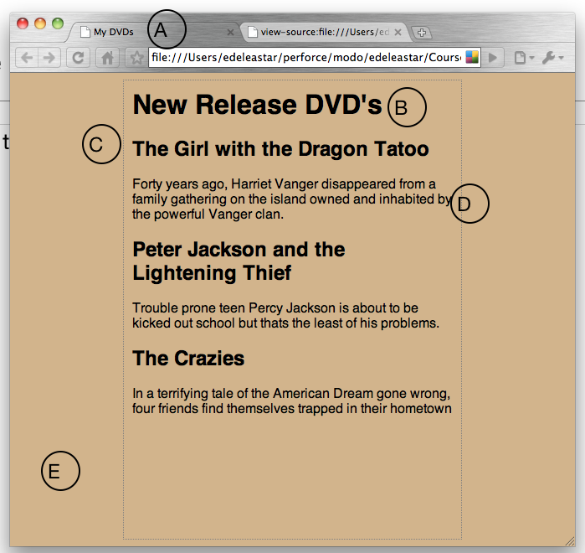
The Page

Slide 34
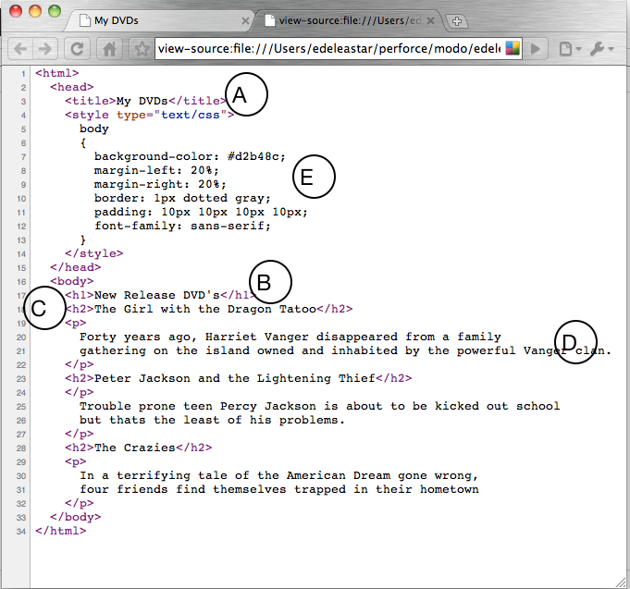
Every word in <> is a Html Element

Slide 35
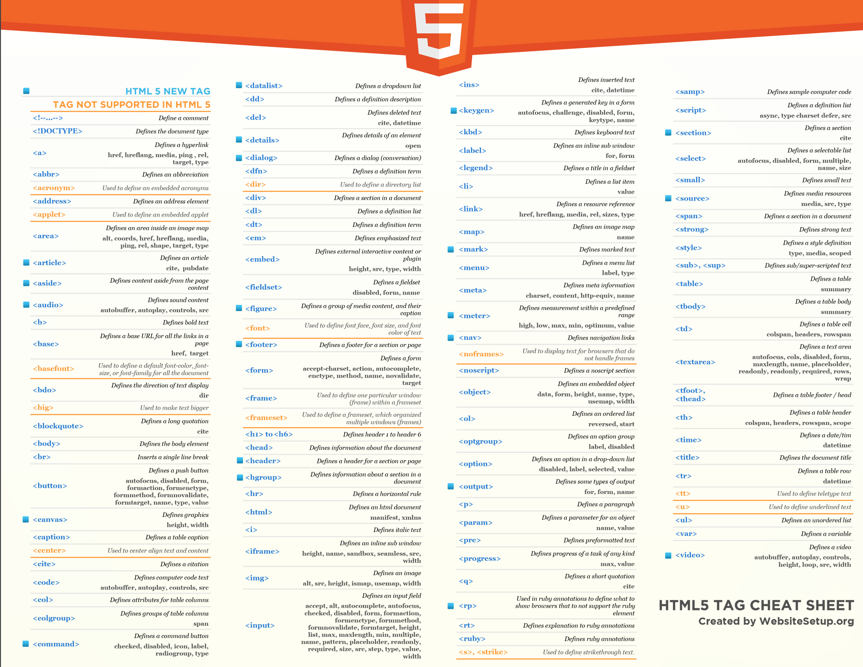

Slide 36
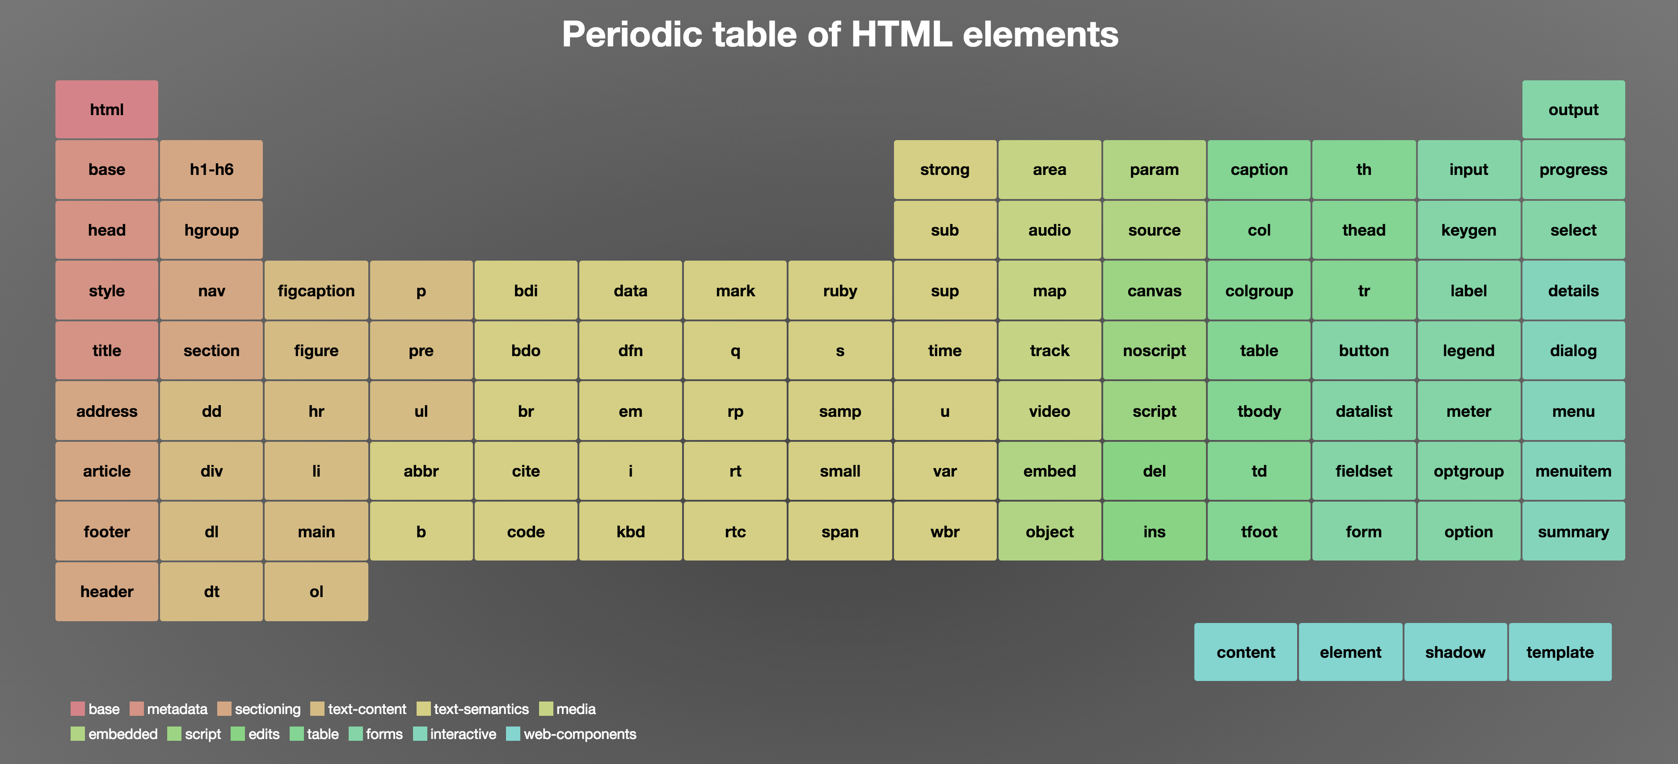


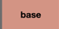
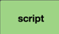
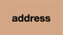




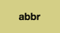



Base
Metadata
Sectioning
Text Content
Text Semantics
Media
Embedded
Script
Edits
Table
Forms
Interactive
Web Components
Major Categories of Elements

Slide 37
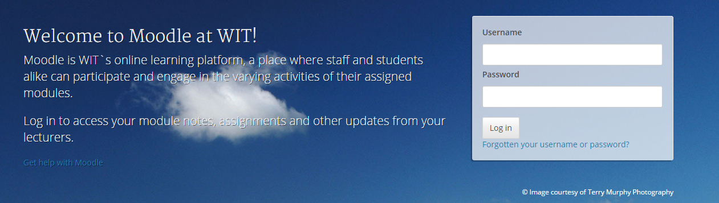
Moodle
https://moodle.wit.ie

Slide 38
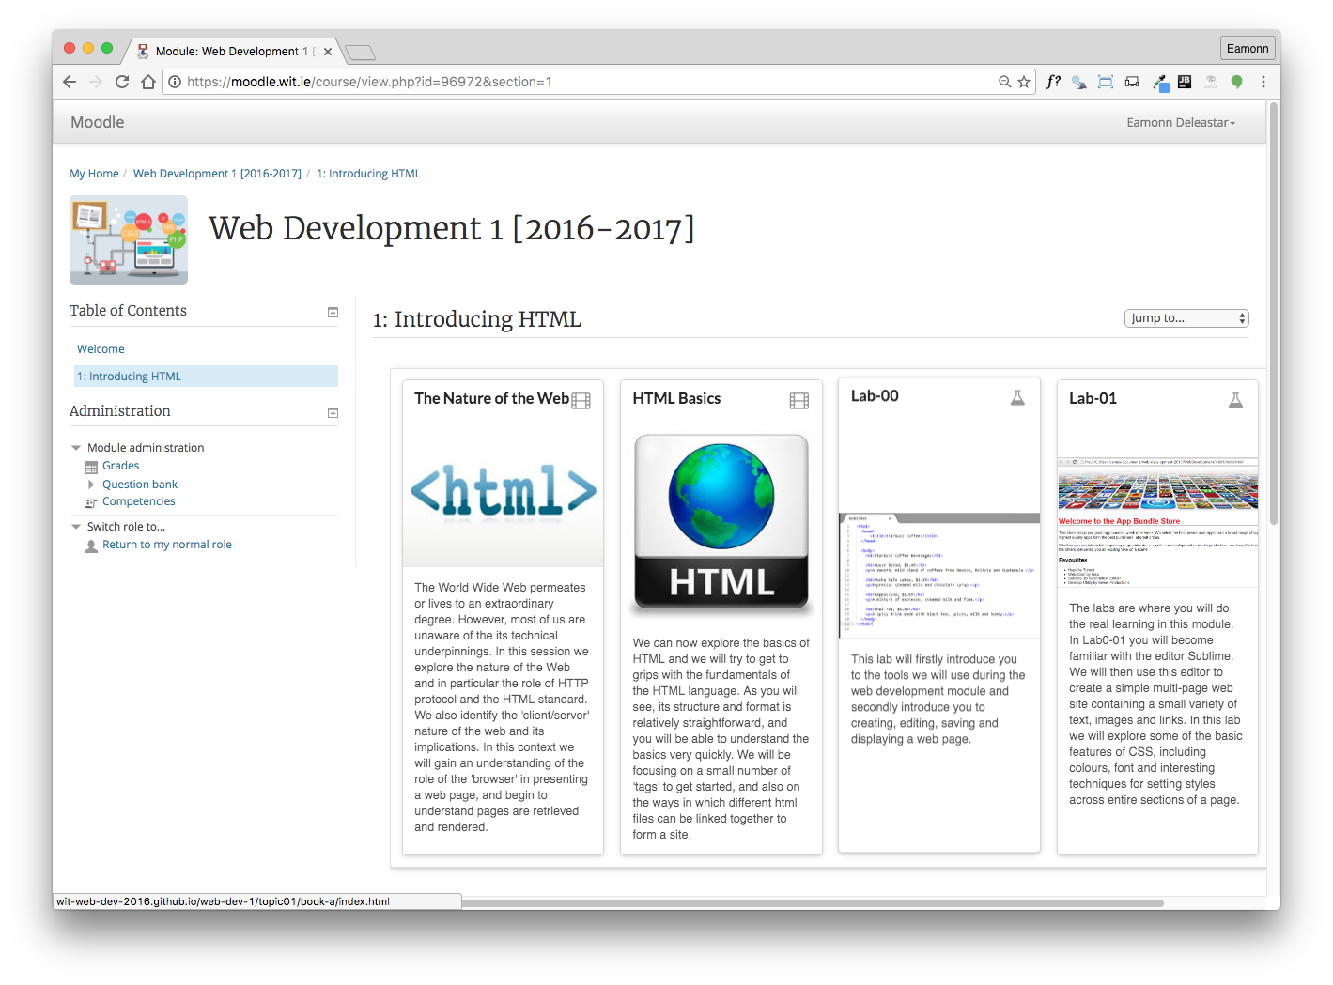
Weekly topic area with links to pdf document for each lecture and a link to the current weekly lab(s).
38

Slide 39
Labs Philosophy
Learn by Doing
Supported by reading Associated chapter in Head First HTML (in general, 1 chapter per lab)
Supervised by module team
Do Exercises & Don’t be afraid to experiment - you cant break the web!

Slide 40
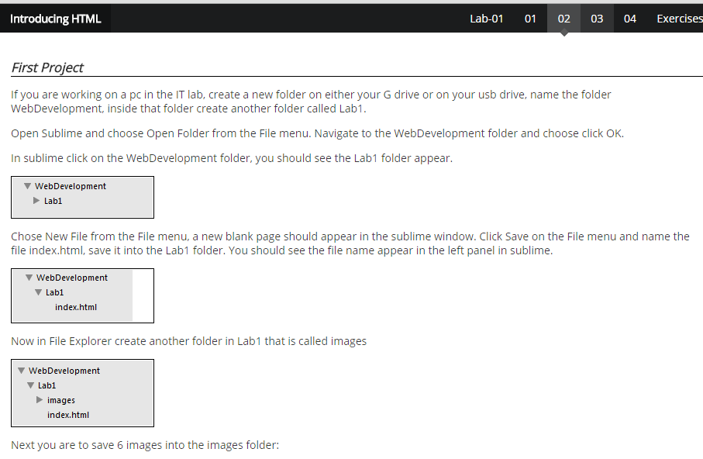
Labs
Steps
Instructions for each step

Slide 41
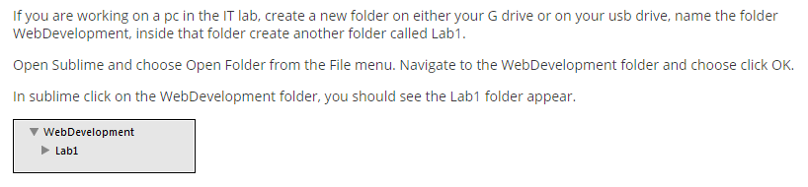
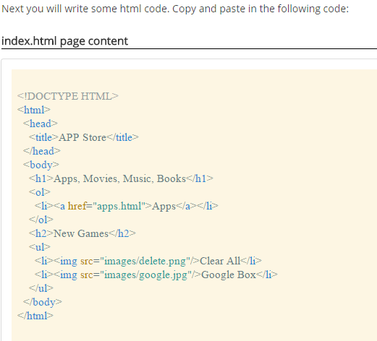
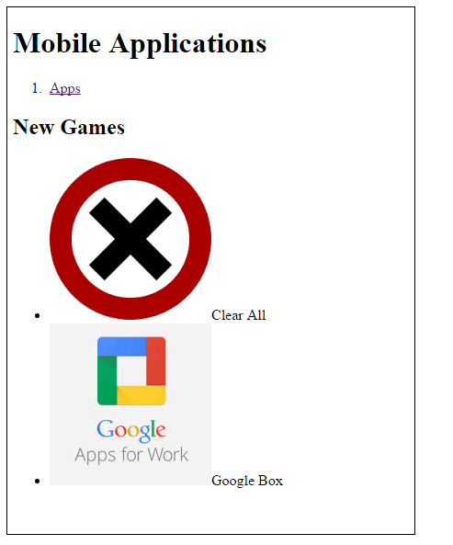
Typical Step:
Short motivation
Screen shots to show outcome
Some html to type
More screen shots to
show expected outcome
Not a race! - Take your time
2 hours timetabled/supervised
Reflect as you go along

Slide 42
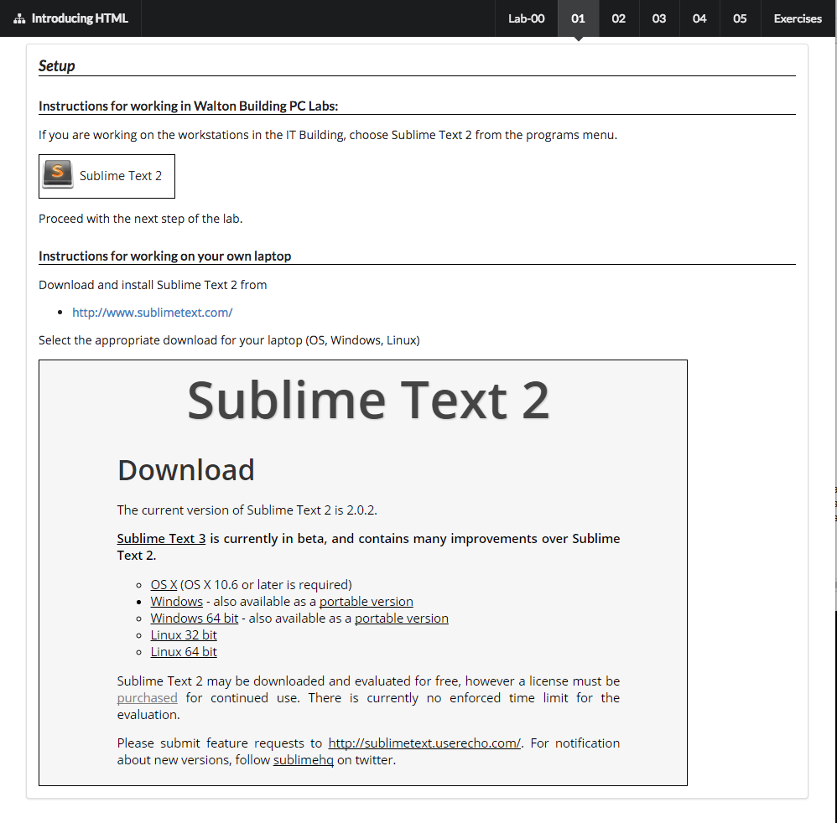
Objectives for Lab 00
Introduce you to the tools we will use during the web development
Introduce you to creating, editing, saving and displaying a simple web page.

Slide 43
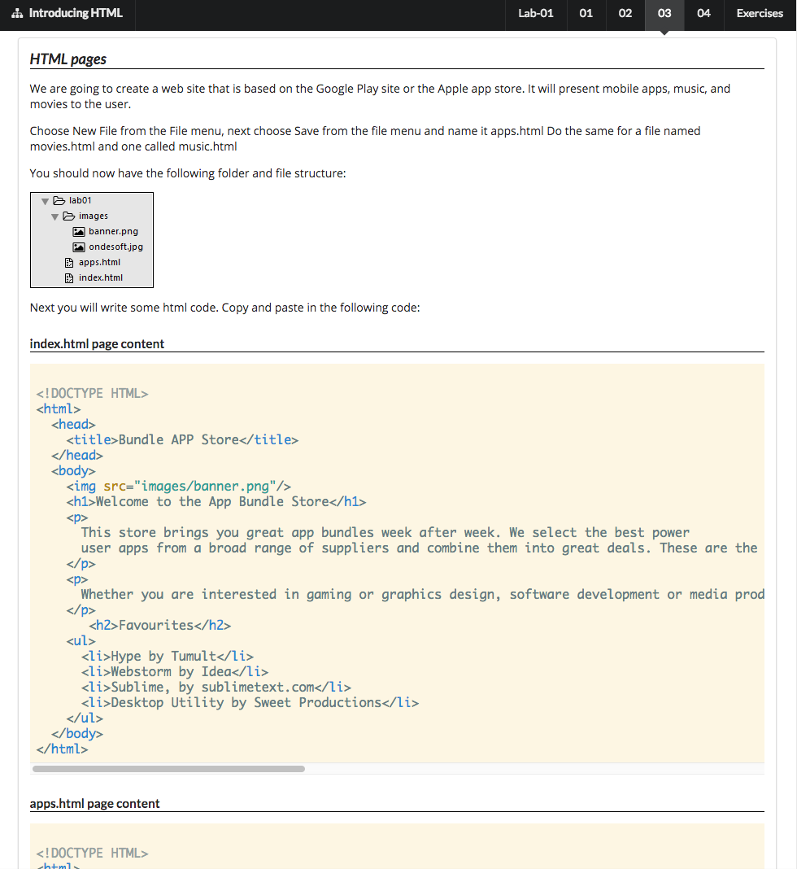
Objectives for Lab 01
Be able to download and install Sublime Text 2, and understand its key features.
• Create a WebDevelopment folder to contain a new Lab folder each week.
• Create a simple static web site, and be able to manage it within the Sublime environment
Familiar with the following HTML elements:
<html> <head> <title> <link> <body> <h1> <h2> <p> <a> <img> <ul> and <ol>

Slide 44
Good Luck!

